Slide 1
WELS Christian Aid and Relief
Notes:
I’m Pastor Dan Sims and it’s my privilege to serve you as the Director of WELS Christian Aid and Relief, one of our synod’s ministries of compassion.
Serving with me is a five-man Commission made up of three pastors, a teacher, and a layman. Pastor Tom Spiegelberg is the Commission chairman.
We also have a full-time administrative assistant, Mrs. Beth Zambo.
I’d like to show a brief video that will give you an overview of this ministry and summarize our activities over the past biennium.

Slide 2
Our Mission
As we have opportunity, let us do good to all people, especially to those who belong to the family of believers (Galatians 6:10).
Notes:
Our theme passage is found in Galatians 6:10. Our God wants us to care for the needs of our brothers and sisters, but we don’t stop there. He wants us to reach out in compassion to others as well.

Slide 3
Our Mission
Our mission is to reflect Christ’s love and compassion to souls suffering from disasters and hardships (mercy/compassion ministry).
Notes:
This kind of work is often called mercy or compassion ministry.

Slide 4
Three Main Services We Provide
Disaster Relief
Humanitarian Aid
Personal Relief Grants
Notes:
The bulk of our work is in three main areas of service: Disaster Relief, Humanitarian Aid (in partnership with WELS Home and World Missions), and personal relief grants. I’ll like to share a little bit about each of those areas.

Slide 5
In all that we do, we strive to . . .
Honor our Savior by imitating his compassion.
Carefully assess needs and opportunities.
Responsibly and effectively utilize the resources provided by God’s people.
Provide a meaningful and positive service experience to our volunteers.
Seize every opportunity to bring the comfort of the gospel to hurting souls.
Notes:
But first let me share some of the principles that guide our ministry:
Honor our Savior by imitating his compassion. Jesus served those who were hurting with great care and compassion. We strive to do the same in his name.
Carefully assess needs and opportunities and responsibly and effectively utilize the resources provided by God’s people. Our donors are very generous and care greatly about helping those in need. We strive to make careful assessments so that we utilize the dollars they have donated responsibly to bring maximum relief.
Provide a meaningful and positive service experience to our volunteers. Disaster relief is hard and often heart-breaking work. However, it is also a joy to help those in need in our Savior’s name. We strive to give our volunteers a positive experience as they assist those who are hurting.
Seize every opportunity to bring the comfort of the gospel to hurting souls. Those who have been through a disaster or other great difficulty are often open to hearing about the Savior we serve. In our work God gives us many opportunities to proclaim the good news.

Slide 6
Disaster Relief
In FY22-23 we have utilized $611,003 for disaster relief.
Notes:
In FY 22-23 we utilized about $600,000 for Disaster Relief. I’ll share with you some of the highlights. Here are some examples of that work from the last two years.

Slide 7
Earthquake in Haiti
Notes:
Following an earthquake in Haiti we partnered with Branch Lutheran Schools to help rebuild the homes 30 school families whose homes were destroyed.

Slide 8
Hurricane Ida
Notes:
After Hurricane Ida hit the Gulf Coast we partnered with our congregations in Louisiana to bring relief including the deployment of crews to help replace several roofs for members of our congregation in New Orleans.

Slide 9
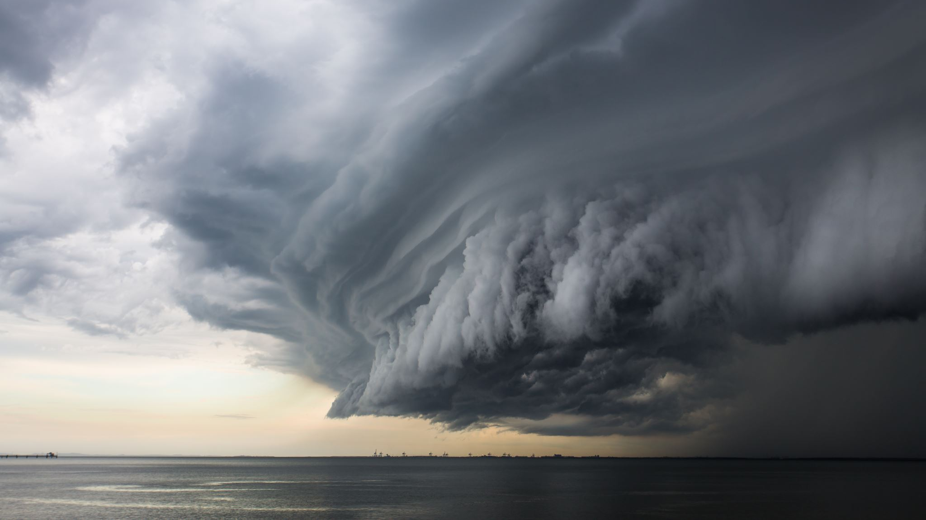
Hurricane Ian
Notes:
Hurricane Ian was our biggest disaster deployment in the past two years.

Slide 10
Notes:
Five of our congregations were impacted by Ian, suffering various levels of damage. All five congregations needed new roofs. Some needed new drywall and other repairs.

Slide 11
Hurricane Ian
Notes:
Here are some photos of typical damage.

Slide 12
Hurricane Ian

Slide 13
Hurricane Ian

Slide 14
Hurricane Ian
Notes:
We are truly grateful for our caring and hard-working volunteers.

Slide 15
Hurricane Ian

Slide 16
Hurricane Ian
Notes:
One great blessing of our Hurricane Ian deployment was the opportunity to partner with Builders for Christ. Their volunteers were a huge help. We couldn’t have gotten the work done without them.

Slide 17
War in Ukraine
Notes:
Of course, the onset of war brought great suffering to the people of Ukraine. We have worked in partnership with WELS World Missions and our brothers and sisters in the Ukrainian Lutheran Church to bring relief to those who are suffering. This relief has mostly been given through the gift of basic supplies like food, clothing, medicine, and personal items.

Slide 18
Disaster Relief Task Force
Notes:
Our disaster relief task force has been meeting since October of 2022. Our goal is to improve and expand our disaster relief capabilities and to provide more and better training for our volunteers and leaders.

Slide 19
welsdisasterrelief.net
Notes:
One big step in this direction is the establishment of our dedicated disaster relief website at welsdisasterrelief.net. This site includes powerful software that allows us to track and manage our volunteers and disaster relief deployments.

Slide 20
Humanitarian Aid
In FY22-23 we have utilized $387,665 for humanitarian aid efforts with our partners in WELS Home and World Missions.
Notes:
Humanitarian Aid is an important aspect of our ministry and one to which many dollars are dedicated. In FY 22-23 we utilized almost $400,000 for humanitarian aid efforts. For FY 23-24 we approved more than $700K in grants to be used by home and world missionaries to reach out to their communities with the compassion of Christ and provide basic needs for people who are struggling.

Slide 21
Boreholes
Notes:
Some examples include: Boreholes in Africa to provide clean drinking water.

Slide 22
Medical Care
Notes:
Medical care for the sick and dying.

Slide 23
Vocational Training
Notes:
Vocational training to provide an income stream for the poor.

Slide 24
Smokeless Stoves
Notes:
Smokeless stoves that provide for safer heating and cooking in homes.

Slide 25
Food Support
Notes:
Support for those who struggle with food insecurity, and many other examples.

Slide 26
Notes:
Last year we introduced a new program called the Community Care and Compassion matching grants program. This program provides annual matching grants of up to $2,500 for self-supporting WELS congregations who reach out to their communities with some kind of compassion ministry. So far, we have granted more than $60,000 to encourage compassion efforts in our congregations.

Slide 27
Personal Relief Grants
In FY22-23 we have utilized $429,252 for personal relief grants.
Notes:
That brings us to personal relief grants. In FY 22-23 we utilized over $400,000 for personal relief grants to assist congregations in ministering to members and prospects going through a serious financial or medical crisis.

Slide 28
Medical Bills
Notes:
Often we assist congregations who have members with medical bills they are unable to pay.

Slide 29
Basic Needs
Notes:
We have helped with basic needs like groceries, utility bills, or rent.

Slide 30
Many Other Needs
Notes:
We have helped with the purchase of a used car for a family in need or a handicap accessible van for a family with a child that has special needs. Pastors who know of someone in crisis in their congregation are encouraged to reach out directly to me. We would love to assist your congregation in helping them.

Slide 31
Not Just a Charity │ A Means of Grace Ministry
Notes:
We do a lot of charitable work, but Christian Aid and Relief is not just as a charity. It is a Means of Grace Ministry. In all that we do, we strive to let the light of Christ shine, connect people with God’s Word, and share the good news of his saving love with people in crisis.

Slide 32
Keep in Touch
Basic information: wels.net/relief
Volunteer: welsdisasterrelief.net
Facebook: WELS Christian Aid and Relief
Contact me to schedule a preacher or presenter (414-256-3204, daniel.sims@wels.net).
Notes:
Please keep in touch with our ministry. Basic information can be found at wels.net/relief. You can sign up as a disaster relief volunteer at welsdisasterrelief.net. The best way to keep up with the latest news is through our FB page. And if you’d like a preacher or presenter for your congregation, school, or group, please reach out directly to me.
We thank you for your generous support and your partnership in sharing the compassion of Christ.

