Slide 1
Brad Price
President/CEO
Notes:
You may have noticed that I stay in back most of the time. It’s hard for me to focus on the speaker or anything else. Much of my attention is aimed at each door and everyone who is in the crowd. I get so anxious about who and when multiple threats will come though those doors. Are there any threats embedded in this crowd. Its all I can do to come for the five minutes that I will get out of an hour-long service. I know I need to be here. But its hard. I feel so empty and so alone. I hate my skin. I’m feel stuck in this deep, dark cavern and there is no way out of this darkness. How can I forgive myself? It’s hopeless. I don’t know what to do anymore.
The chaplain allowed me to do scheduled Bible studies when I was in Afghanistan. It was good for me to be able to share my faith and help others with some of the struggles they had while we were deployed. When I retired from the Army, I felt encouraged to pursue a second career as a pastor. I’m grateful for the opportunity to continue to serve God’s people in a different capacity while still making use of the skills that were developed in my military service.
Good afternoon, my name is Brad Price. I’m privileged to serve Lutheran Military Support Group as their President and CEO. Lutheran Military Support Group is a WELS and ELS affiliated ministry that provides Christ-centered support to our Active-Duty military service members, veterans, and their families. The two accounts I just shared are based on conversations I’ve had with our service members and their families.

Slide 2
Spiritual Retreats
Members with combat-related PTSD and their spouses
Grounded in Lutheran Doctrine
Lead by WELS/ELS Veterans
No cost to attendees
Registration ends August 30
Notes:
Not every service member who deploys or serves in a combat zone will experience PTSD or other associated symptoms. Some are able to manage the effects of their trauma with the help from battle buddies or through therapy. Others will not experience the symptoms of PTSD until later in life, even into retirement. For those who are impacted, it can be debilitating.
Our Spiritual Retreats for Christian Warrior events were developed due to the need of combat veterans in our congregations who struggle with their experiences and the impact it has on their faith. We offer two 4-day retreats: one for veterans and active-duty members themselves who fight the demon of PTSD and related symptoms which was offered in Washington State earlier this year, and new this year is our retreat for Military Couples whose marriages have been impacted in some way due to their combat experiences.
There are three components to our Spiritual Retreats: Spiritual Health, Mental Health, and Veteran Support.
SPIRITUAL – As you heard earlier, Veterans may deal with guilt and shame linked with their service. Sometimes their guilt comes from their action or inaction, or it could come from injuries to their conscience. Workshops include approaching the vocation of warrior from God’s perspective along with addressing their guilt. There are devotions throughout the day and two powerful worship services. On Saturday night is our Confession and Absolution service where everyone in attendance comes to the altar and personally receives God’s forgiveness from the pastor. On Sunday morning, we join together in Word and Sacrament before we return home. Our pastor leading worship and devotions this year is a retired Army Infantry 1st Sergeant, ELS Pastor Roger Emmons. His service dog, Suess, may help officiate.
MENTAL HEALTH - Trauma physically changes our brains and in turn affects how we think and make decisions. A component of our retreats is to educate and provide tools for our attendees that will help them recognize the negative cycles of self talk and reframe their experience. God has created us with magnificent minds and brains. It can be helpful in a person’s journey toward healing to understand how the effects of trauma are linked to both their spiritual and mental health. We are blessed to have Megan McMahon with us as our mental health professional this year. Megan is an Army Combat Veteran and ELS member with her own trauma journey to draw on.
VETERAN SUPPORT - Comradery is one of the blessings of our retreats. One of Satan’s lies is that you are alone in your suffering, and no one will understand the dark cavern that you are in. Those lies get shattered. It is important to share that there is hope and that there is a tomorrow. God has plans to use you and your experience for your benefit and for the benefit of his Kingdom. Our Veteran Support speakers for our upcoming Spiritual Retreat for Military Couples are Steve and Sarah Schroeder. Steve and Sarah will share the challenges of their military experience and how God was present even in tragedy.
Our Spiritual Retreat for Military Couples is October 26-29 at Camp Shiloh, Texas. Registration will close at the end of August and space is limited. There is a small registration fee but there is no cost for attend and financial assistance is available for travel for those who need it. Please share this information with the military couples in your congregation. I have posters on my table outside, they are also in the online delegate resource center, and you can find more information about registering on our website.
It was last year when one of our attendees expressed feeling guilty and ashamed of his service. For two days he heard about God’s grace and forgiveness, and about God’s view of his honorable service as a warrior. It all came to a head during our Confession and Absolution Service when he was lined up in front and the pastor individually absolved him of his sins, both real and those he perceived. This man had been carrying his guilt and shame for years, and it left through tears that night. There is hope and healing in Jesus.
Dealing with PTSD related symptoms can be excruciating for the person affected and their family. It takes courage. Please keep these families in your prayers.

Slide 3
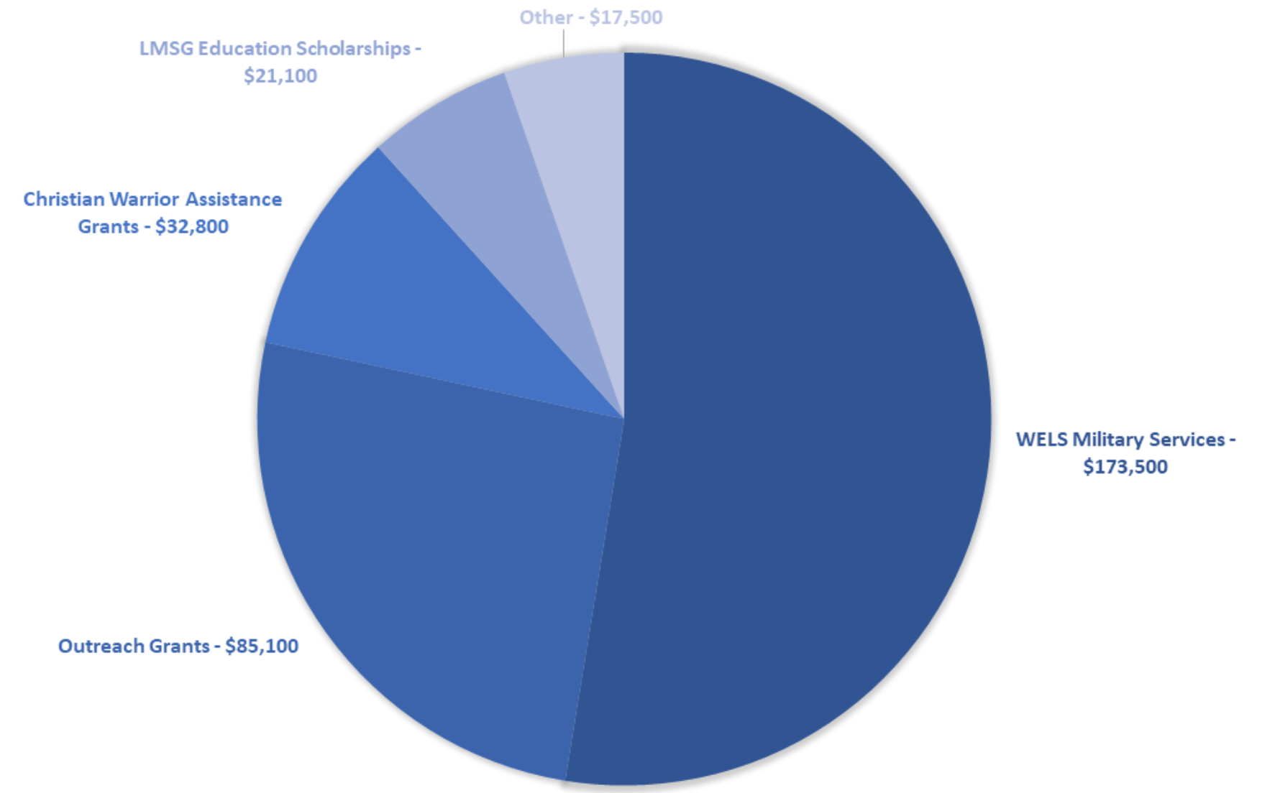
Grants & Scholarships
Notes:
Supporting our WELS/ELS service members living with the demon of PTSD and other trauma related symptoms has always been a focus of LMSG, but before that was the need to support ministry to our military members. It is wonderful news that WELS is moving forward with a full-time National Chaplain to the Military! It is so needed.
Pictured with me here is recent Wisconsin Lutheran Seminary Graduate Paul Ritter, a US Army Veteran and recipient of our Lutheran Military Support Group Scholarship.
Because we have been blessed through our Ammo Can Campaigns, we have been able to award over $330,000 in grants and scholarships going toward ministry to the military, the education of future called workers, and Veteran appreciation/recognition events.
Lutheran Military Support Group Scholarship which is available for active duty and veterans who are pursuing a second career in public ministry at Martin Luther College, Bethany Lutheran College, Wisconsin Lutheran Seminary, and Bethany Lutheran Seminary.
LMSG Military Support Scholarship provides scholarships to active duty or prior service WELS and ELS Service Members enrolled in the Chaplaincy Certification Program at Martin Luther College. This Scholarship can be applied to each course taken by Service Members until completion of the program. WELS and ELS Military Contact Pastors qualify for this scholarship for courses Frontline Chaplaincy (THE9524) or The Spiritual Side of PTSD (THE9601).
Christian Warrior Appreciation Grants are available to congregations or schools to assist them financially in recognizing the Warriors in their congregations and community.
Christian Warrior Assistance Grants are available to Christian Warriors who are in need of financial assistance due to a local disaster, health concern, or unanticipated need due to a deployment. WELS and ELS congregations may be eligible if the grant will go towards helping a military family.
A grant is given each year to WELS Military Services in support of their Military Contact Pastor Workshop, which provides our pastors with valuable insights into the military culture, so they can better serve their Christian Warriors and their families in their congregations and communities.
I’d like to highlight the ELS Military Monument for a moment, for which LMSG was a donor. If you are in the Mankato, Minnesota area, please take time to visit the Bethany Lutheran College Campus. This monument does a fantastic job of illustrating God’s honorable calling of the warrior profession. ELS Military Monument - Evangelical Lutheran Synod
For more information on our grants and scholarships, please see our website.

Slide 4
Ammo Can Campaign
Make a difference
Display in May and November
Support Active-duty, Veterans, and their Families
Contact us to get your Ammo Can
Notes:
We are able to do this important work because of the generosity of many WELS and ELS congregations, schools, and individuals in support of our Ammo Can Campaigns.
As you can see, your financial gifts are being used to directly support Christian Warriors and their families impacted by combat related trauma. Your gifts directly and indirectly support of those pursuing public ministry or engaged in ministry to our military community. You and your gifts matter and make an impact!
If you are not familiar with our Ammo Can Campaign, each May and November, for Memorial Day and Veterans Day, participating congregations put out an LMSG supplied Ammo Can to place donations in. Those gifts are sent to us and support the programs shared here and others.
LMSG Mailing Address:
LMSG
PO Box 483
New Ulm, MN 56073

Slide 5
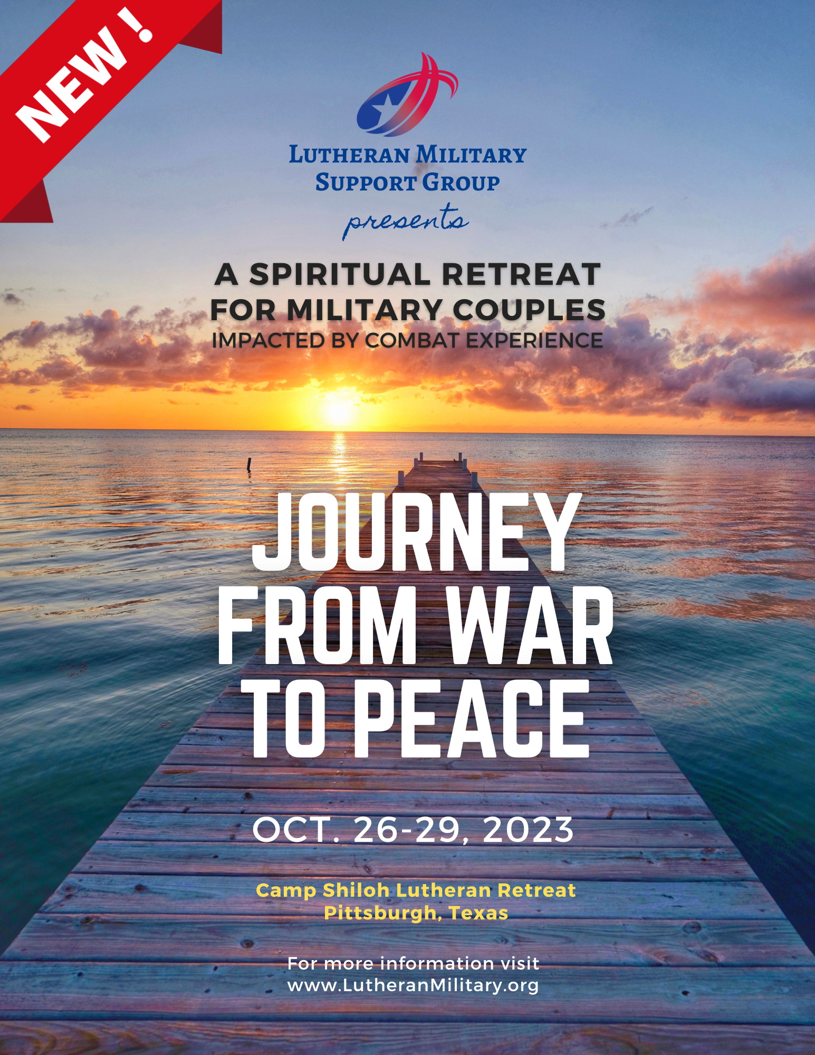
www.LutheranMilitary.org
Info@LutheranMilitary.org
Notes:
If your congregation does not participate and would like to, or you would like to make an individual donation to our ministry, information is available on our website.
This is our poster for our upcoming retreat in October. Please share the information about this retreat with the military couples in your congregation.
Thank you for standing shoulder to shoulder with our Military members and their families and LMSG.

