Slide 1
WELS Congregational Services
Report to the 2023 synod convention

Slide 2
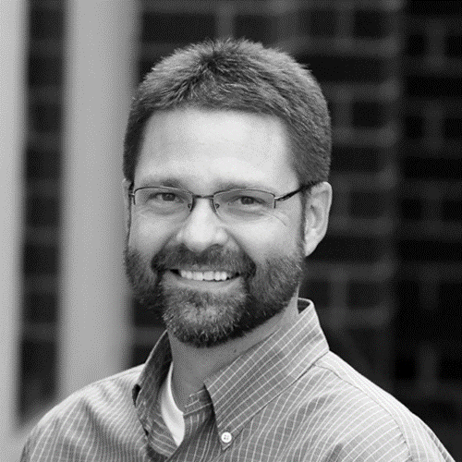
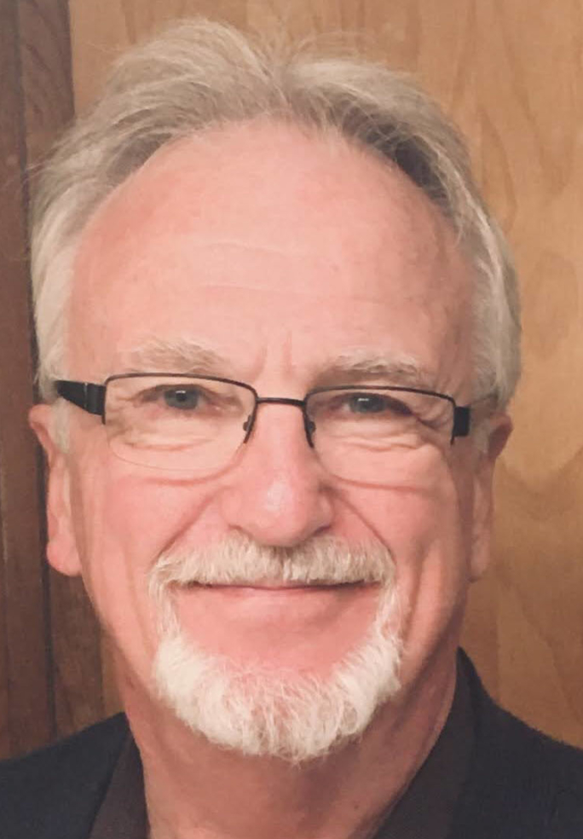
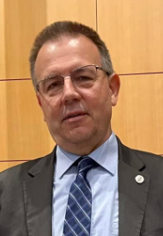
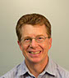
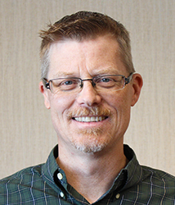
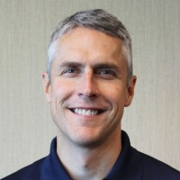
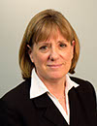
CONGREGATIONAL SERVICES
CONGREGATIONAL COUNSELING
Jonathan Hein
Coordinator of
Congregational Services
CS OPERATIONS
Dan Nommensen
LUTHERAN SCHOOLS
Jim Rademan
Associate Coordinator of Congregational Services
EVANGELISM
Eric Roecker
WORSHIP
Bryan Gerlach
DISCIPLESHIP
Donn Dobberstein
SPECIAL MINISTRIES
Joel Gaertner
WELS SCHOOL ACCREDITATION
Paul Patterson
EARLY CHILDHOOD MINISTRIES
Cindi Holman
Jim Behringer

Slide 3
MINISTRY FOR YOU
World Missions
Home Missions
Ministerial Education
MINISTRY WITH YOU
Congregational Services
WELS Congregational Services seeks to encourage and equip congregations for faithful and fruitful gospel ministry.

Slide 4
Church & School Consultations
2022 = 12% of WELS congregations
Goal by 2025 = capacity for 20% of WELS congregations
Self-Assessment & Adjustment Program (SAA)
AXIS Program
(Long-Range Planning)
Ministry Organization & Staffing Evaluation (MOSE)
WELS School Accreditation (WELSSA)
Merging
for Mission
(M4M)
Leader Reflections
(coming 2024)
Everyone Outreach
(Creating a Mission Culture)
Telling the
Next Generation (TTNG)
Notes:
This is approximately a doubling of the number of churches that were worked with in 2017. We hope in two years to have the capacity that we could work with 20% of churches annually.

Slide 5
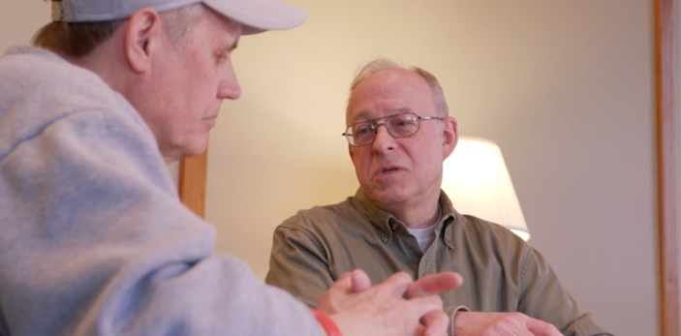
Congregational Resources
MINISTRY TRAINING
Chaplaincy Training
(evangelism training)
(shepherding/elder training)
STANDING UP FOR CHILDREN
A Christian Response to Abuse and Neglect
(prison ministry training)
Mentoring a Returning Citizen

Slide 6
Congregational Resources
MINISTRY RESOURCES

Slide 7
Congregational Resources
PERSONAL RESOURCES

Slide 8
Worship plans for every week
Preacher Podcast for every week
Outreach graphics and videos for each series
Promotional text for every week
Outreach implementation plan
School devotions
Teen devotions/studies
Coordinates with WELS online daily devotions
welscongregationalservices.net
83,000 engagements in the first year

Slide 9
75% of congregations are using the new hymnal
Over 550 subscribe to Service Builder
Those considering adoption:
christianworship.com
welscongregationalservices.net/hymnal-introduction-resources
online.nph.net/cwsample
Musician’s Resource available at nph.net
Service Builder Playlist now available
Notes:
75% of WELS congregations are using the new hymnal. Over 550 churches use Service Builder, enabling them to quickly easily produce beautiful worship folders. If you’re from the 25% not yet using the hymnal, we encourage you to check it out.
NPH is the source for the most up-to-date and accurate information about all things CW – not a neighboring church or pastor or your district worship coordinator.”

Slide 10
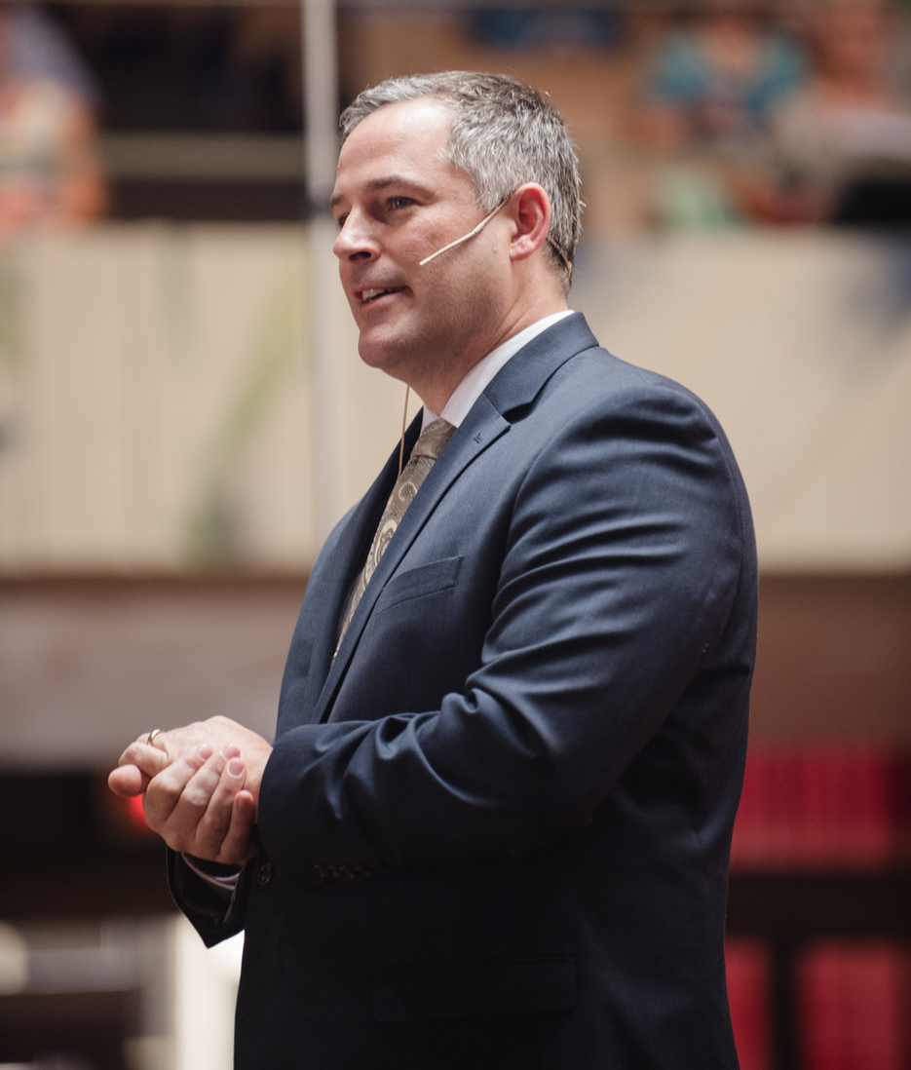
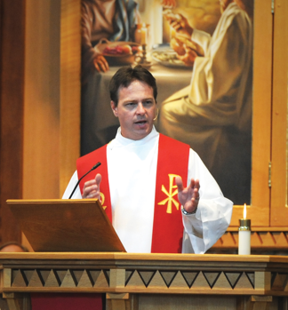
PASTOR JON ZABELL
PASTOR MICHAEL SCHULTZ
Notes:
Pastor Jon Zabell has served 12 years as commission chairman including seven years as chairman of the Hymnal Project.
Michel Schultz was the director of the Hymnal Project. We thank them and the more than one hundred volunteers and the NPH team for giving us these ministry resources.

Slide 11
Now Available:
“A Time for Everything”
Four weeks of worship, sermons, and Bible studies:
A Time to Prioritize
A Time for Perspective
A Time to Plan
A Time to Pause
Notes:
“A Time for Everything”– Stewardship is the lifelong management of all the resources God has given us . . . including a quickly depleting resource called “time.” How we manage the time we have left has huge implications on what we as individuals and as a church do for the rest of our lives. “A Time for Everything” provides four weeks of worship, sermons, Bible studies, and devotional resources as congregations consider these important times: A Time to PRIORITIZE, A Time for PERSPECTIVE, A Time to PLAN, and A Time to PAUSE. This resource is now available.
In the coming biennium, resources will be developed for Talent, Treasure, Temple, and Truth. Together, they will form “The Stewardship Legacy Series.”

Slide 12
IRON
SHARPENS
IRON
creating a culture of feedback

Slide 13
LOCAL
COME & SEE
encouraging and equipping Christians for invitation evangelism
helping regional churches establish a local presence
Notes:
More than 70% of unchurched people surveyed say they would be at least somewhat likely to accept an invitation to church from a churched acquaintance. Yet, many WELS members have never invited an unchurched person. We hope to help WELS congregations understand what may be keeping their members from proffering invitations, remove unnecessary obstacles, and encourage and equip members to do invitation evangelism
Many WELS congregations have members who travel a significant distance to worship. 30-60 minutes is not unusual. This makes it difficult for members to invite neighbors to join them for worship, BIC or congregational fellowship activities. Local will help congregations in such a situation create a presence in their local communities to reach the lost in their neighborhoods.

Slide 14
CHURCH GOVERNANCE RESOURCES
Bible study on the purpose of governance
Updated constitution models
Resources for district constitution committees

Slide 15
WELS Committee on
Identity, Gender, and Sexuality
Objectives for this biennium:
Development of a website for those who are struggling
Creation of a speaker’s bureau to present on these issues
Creation of church/school resources to provide policy guidance and recommendations

Slide 16
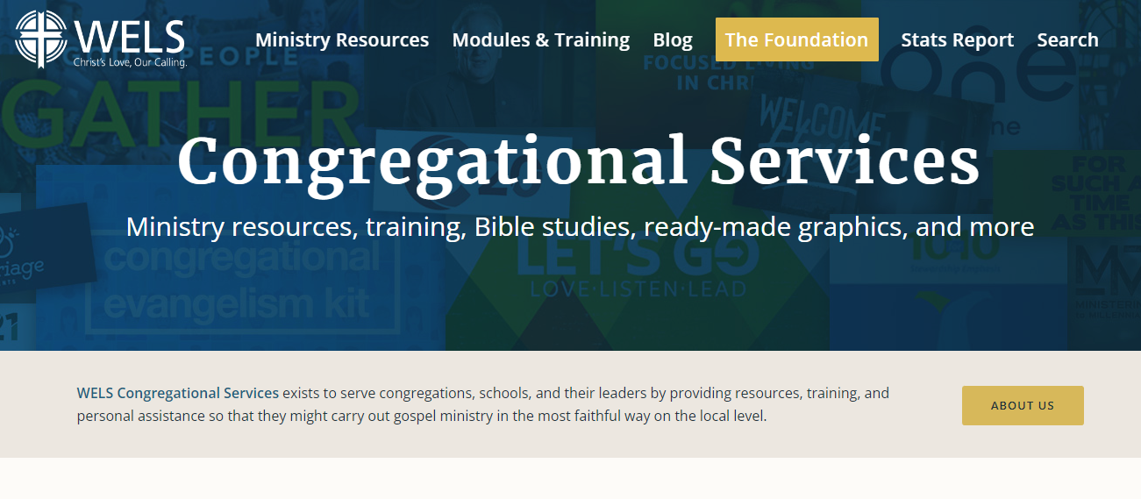
welscongregationalservices.net

Slide 17
Ministry/Discipleship Gatherings
WELS NATIONAL CONFERENCE ON LUTHERAN LEADERSHIP
WELS NATIONAL CONFERENCE ON
WORSHIP, MUSIC, & THE ARTS
WELS NATIONAL EDUCATION CONFERENCE
WELS INTERNATIONAL
YOUTH RALLY
Notes:
This is approximately a doubling of the number of churches that were worked with in 2017. We hope in two years to have the capacity that we could work with 20% of churches annually.

Slide 18
July 28-30, 2024
Notes:
Women’s Ministry - produces a broad range of resources for women to be active in the Body of Christ. In addition to providing downloadable congregational ministry resources (Advent by Candlelight, women’s devotions, etc.), they will host a women’s conference next summer for relationship building and equipping women for greater service.
New this year: online webinars for greater accessibility and to better reach the younger generation of WELS women. It seems to be working. This past week (July 27th ) over 350 women/mothers of all ages joined an online webinar to confront the challenge: How can each of us work to foster faith in the next generation? The panelists were real parents who could speak to the challenges of hectic schedules but the importance of building a habit of devotional life in the home across the spectrum of ages.
These webinars are held quarterly

Slide 19
Notes:
WELS Discipleship is about growing faith in the hearts of our church members/families that then is activated in a life of service. In particular, the group that rightly garners most concern about leaving church are young people. To assist parents and churches, weekly teen devotions and video-based teen studies can be found at the CS website. Congregational Services hosts every other year …
The WELS Youth Rally – the upcoming youth rally at Colorado State University in 2024 will celebrate 50 years of gathering WELS teens through the generations. It’s an unforgettable event as thousands of youth and their leaders experience worship, workshops topics designed just for them, and extra-curricular activities that allow them to truly see they are not alone in their faith.

Slide 20
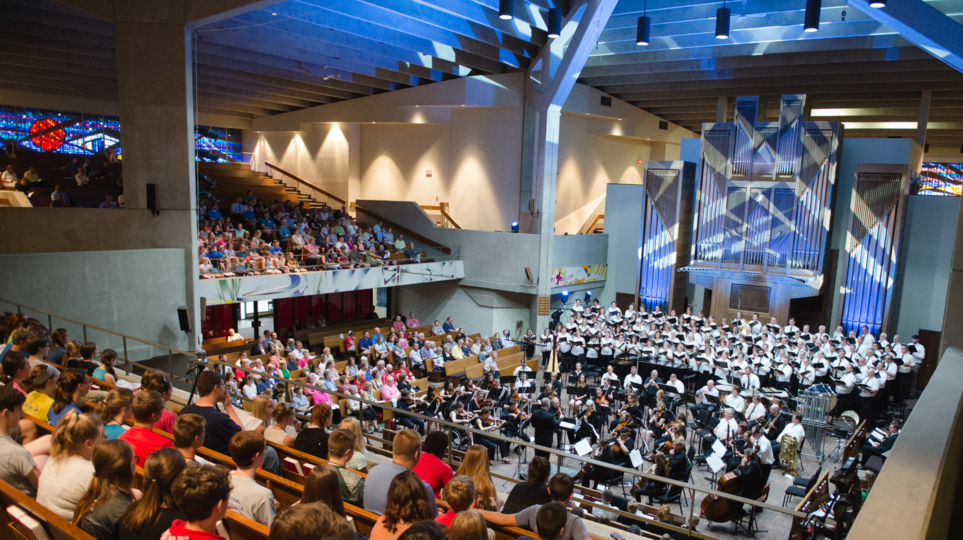
WELS NATIONAL CONFERENCE ON WORSHIP, MUSIC, & THE ARTS
Carthage College―Kenosha, WI
July 30–August 2, 2024
Notes:
WELS national worship conferences had been held every three years since 1996.
But various factors, including the pandemic, caused a seven-year hiatus. Finally the conference is returning in 2024.

Slide 21
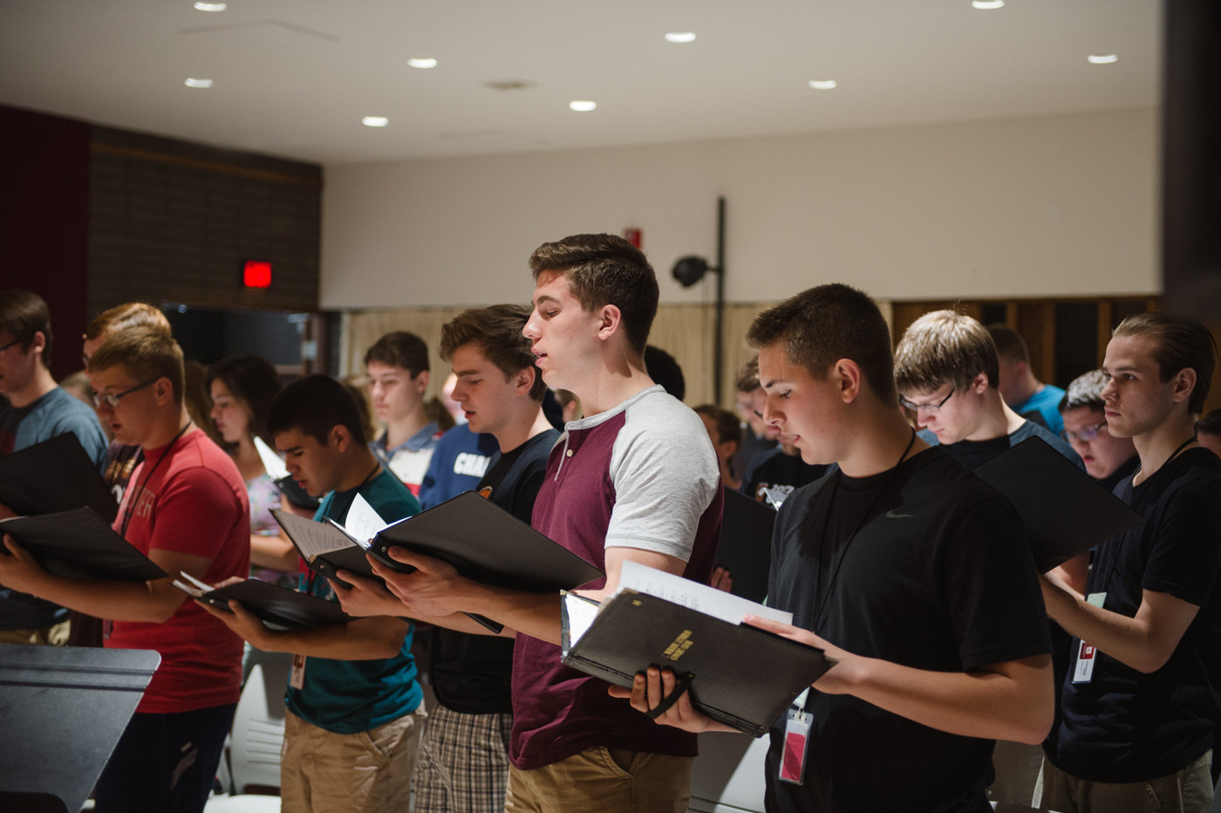
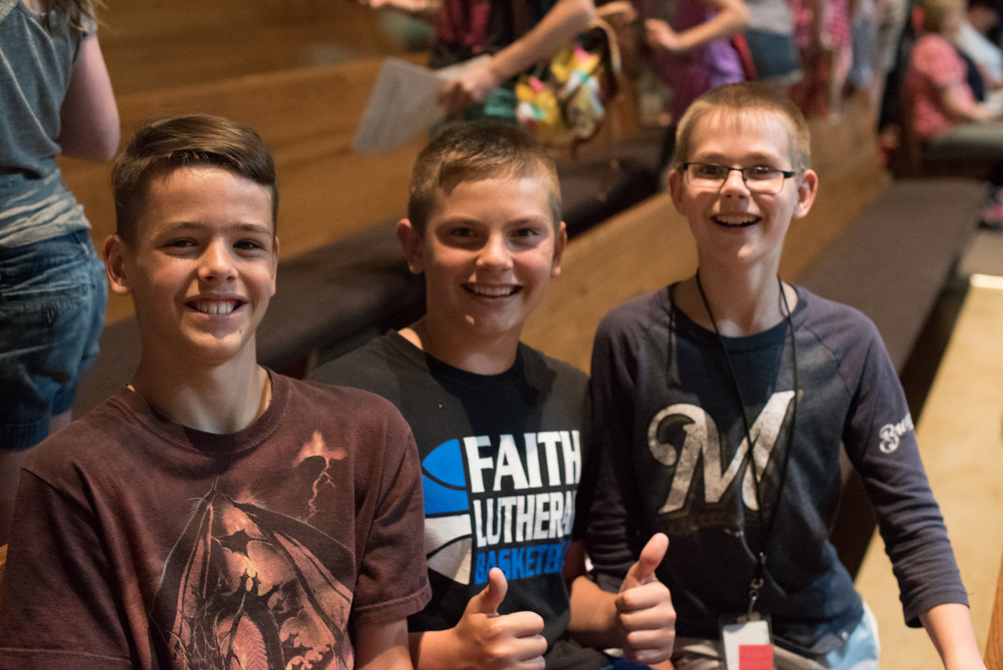
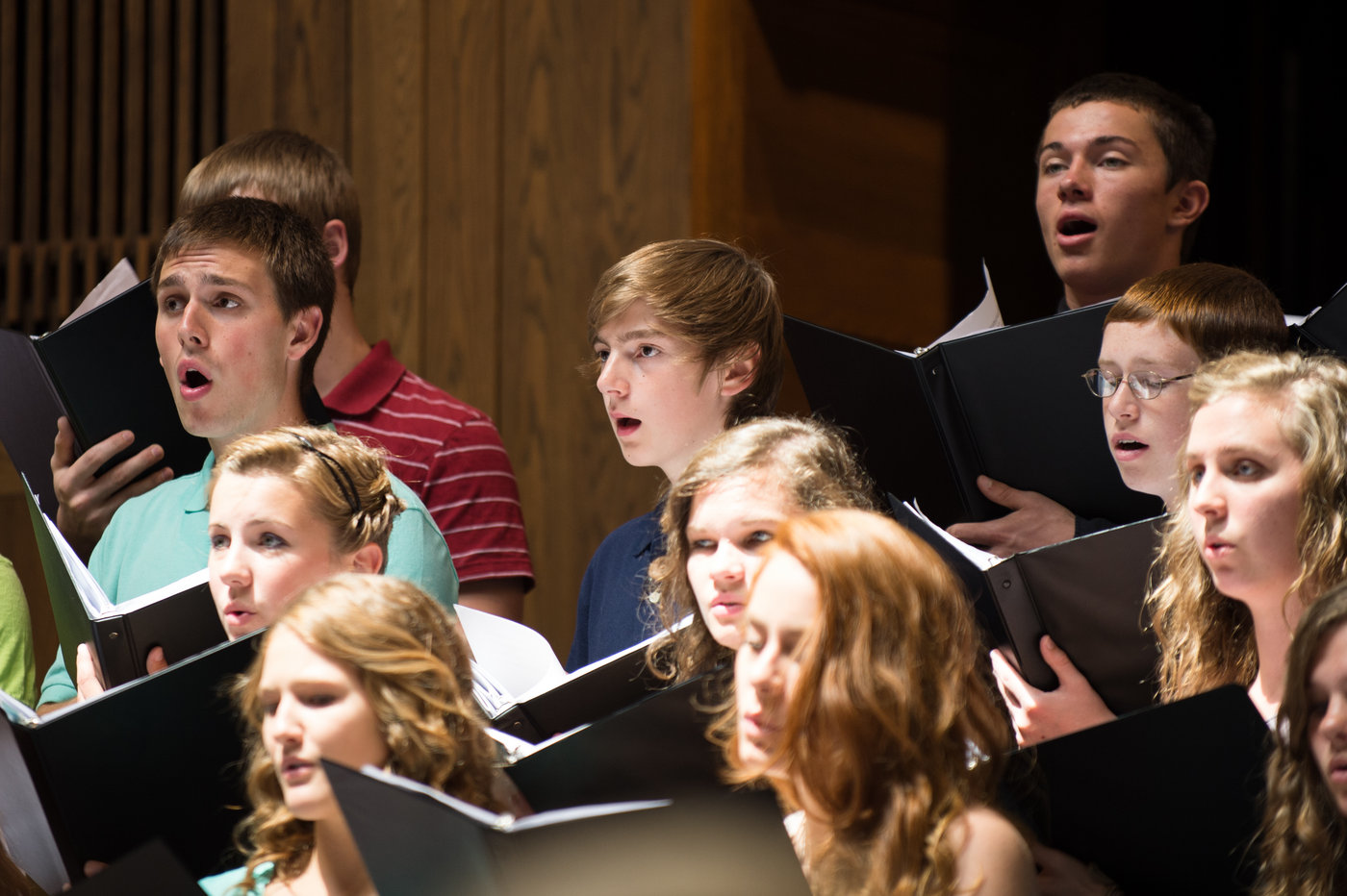
wels.net/worshipconference
Notes:
This conference isn’t only for adults. It features a children’s choir and a high school honor choir.
And it’s not only for pastors, musicians, and teachers. Each of six breakout presentations includes topics of general interest to lay people.
And, of course, the worship is awesome – an inspiring glimpse of heaven.

Slide 22
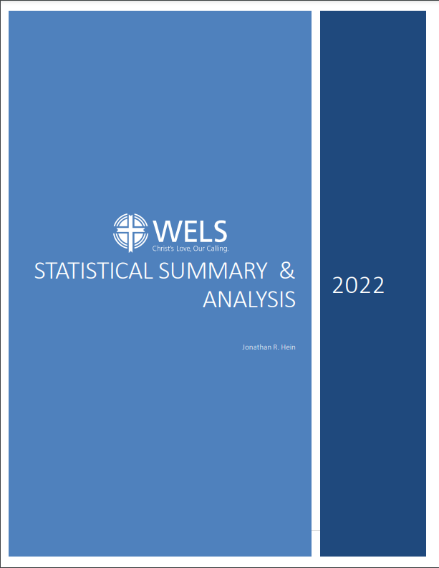
Statistical Analysis

Slide 25
TALKING POINTS for tonight
The belief: “Our young couples simply need to have more babies.”
The belief: “The growing interest in private Christian education will lead to more adult confirmations, as more unchurched students enroll in our schools.”
The belief: “With the large number of pastoral vacancies, we can’t/shouldn’t attempt to start 100 in 10.”
The belief: “To reach the lost requires [insert your personal silver bullet].”
The question: What would, by God’s grace and blessing, enable us to address the challenges before us?

Slide 26
WELS COMMISSION ON
LUTHERAN SCHOOLS
Advance the gospel ministry by supporting and encouraging excellence in WELS schools

Slide 27
Evaluates educational ministries based on Scripture and sound educational principles
Identifies strengths and develops an improvement plan
Awards accreditation and co-accreditation through the National Council for Private School Accreditation (NCPSA)
156 Educational
Ministries Accredited
Self-funded
Continuous improvement
Notes:
16 High Schools
139 Elementary Schools
94 Early Childhood Ministries
Recent Improvements:
ECM Revision
Application to WI Quality Rating System for recognition
LES Standards Revision

Slide 28
Ministerial Growth & Evaluation Process
Ongoing teacher growth for increased student learning
www.cls.welsrc.net
Ministerial Growth and Evaluation Process (cls.welsrc.net/mgep)
Notes:
16 High Schools
139 Elementary Schools
94 Early Childhood Ministries
Recent Improvements:
ECM Revision
Application to WI Quality Rating System for recognition
LES Standards Revision

Slide 29
WELS Schools Pre- & Post-COVID
2019/2020
2022/2023
WELS SCHOOL LOCATIONS
436
422
WELS TOTAL SCHOOLS (ECM, LES, LHS)
688
675
WELS STUDENT ENROLLMENT
42,233
46,601
WELS CALLED TEACHERS
2,814
2,978
Notes:
Overall WELS enrollment has grown by 10.3% pre-Covid school year to current school year. We also have 5.2% more teachers. The number of schools has decreased for two reasons: Some smaller schools (mainly pre-schools) did not survive, and several schools combined. Some locations have one school unit, while others may have ECM and LES, while a few have ECM,LES, and LHS

Slide 30
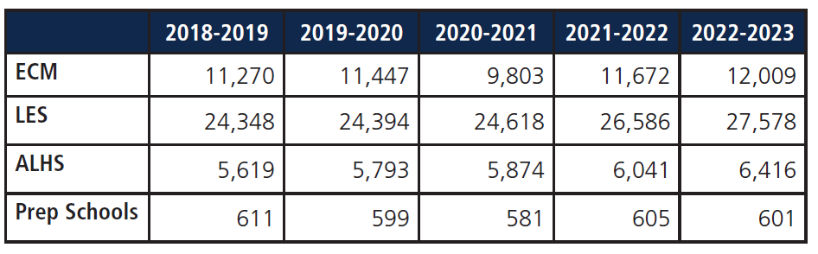
Enrollment Trends
Notes:
Pre-Pandemic Post Pandemic
EC 4.9%
LES 13.8%
ALHS 10.9%

Slide 31
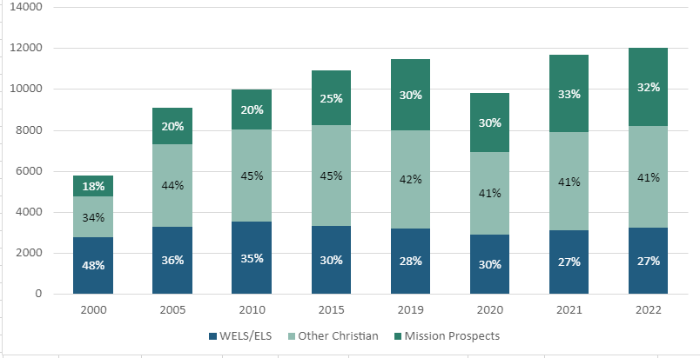
Early Childhood Enrollment Breakdown
Notes:
Pre-Pandemic Post Pandemic
EC 4.9%
LES 13.8%
ALHS 10.9%

Slide 32
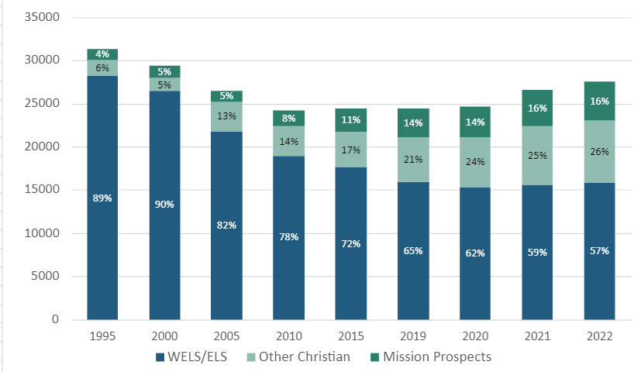
Lutheran Elementary School Enrollment Breakdown
Notes:
Pre-Pandemic Post Pandemic
EC 4.9%
LES 13.8%
ALHS 10.9%

Slide 33
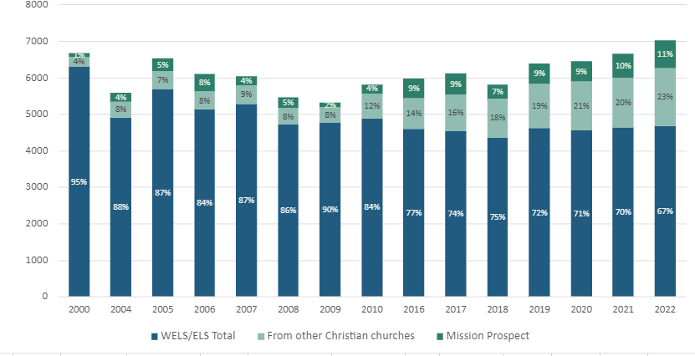
Lutheran High School Enrollment Breakdown
Notes:
Pre-Pandemic Post Pandemic
EC 4.9%
LES 13.8%
ALHS 10.9%

Slide 34
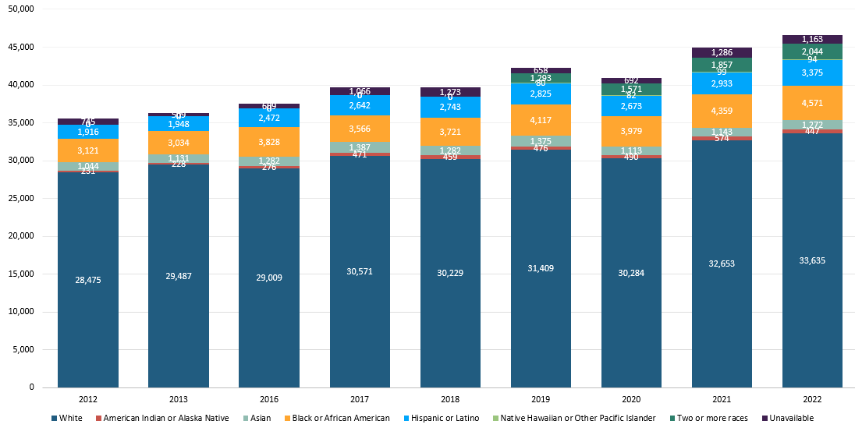
Ethnicity Breakdown in WELS Schools
Notes:
Pre-Pandemic Post Pandemic
EC 4.9%
LES 13.8%
ALHS 10.9%

Slide 35
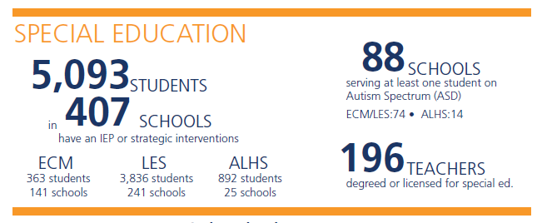
Special Education in WELS Schools

Slide 36
Demographic Shifts in WELS Schools
Fewer/static number of WELS children served
Growing academy model with high tuition and high expectation in areas thirsting for a Christian school―mission prospects
Steadily increasing low-income and ethnically diverse students
Serving more and more students with widening gaps of special education
Many more mission prospects
that we need to better reach

Slide 37
Objective: WELS schools and early childhood ministries maximize the opportunities to share the precious truths of God’s Word with all children and families they serve. ​
​Purpose: Inform, equip, and support congregations in developing and implementing an effective harvest strategy that connects those they serve with the gospel.​
​Goal: Every WELS school and early childhood ministry would have the opportunity to attend a workshop and develop and implement an effective harvest strategy.

Slide 38
Is your ministry financially sustainable?
Notes:
52% of our schools rely heavily on the congregation for funding
61% of our schools believe their sustainability is in question
63% of our school leaders believed that a stewardship drive had not taken place in the last 3 years or more or don’t recall one ever taking place
77% of our school leaders believed that a Christian Giving Counselor visit had not taken place in the last 3 years or more or don’t recall one ever happening

Slide 39
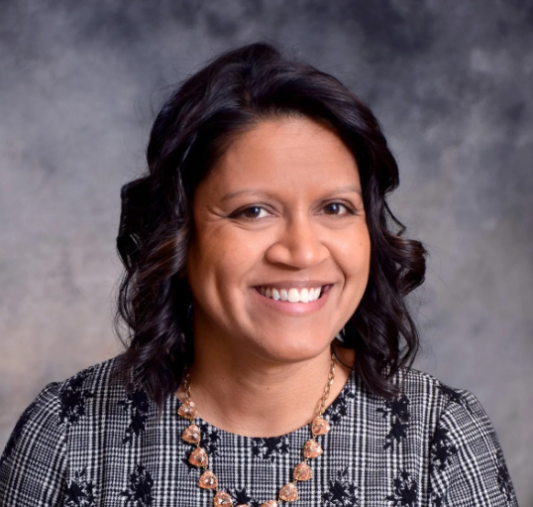
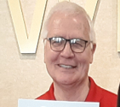
WELS Lutheran Schools
Part-Time Specialists
Melanie Giddings
New WELS Theology Standards and Curriculum Coordinator
50% WELS, 50% Fox Valley
James Sievert
WELS School Consulting Services
25% plus
Notes:
God’s richest blessings for the team at the Commission on Lutheran Schools. Jim Sievert, particularly, who is our ¼ time school consultant is extremely busy and has used several from the NW district to join him on school consultations for new starts, mergers, or challenges and opportunities. We also welcomed Melanie Giddings on July 1. She shares time 50-50 with Fox Valley Lutheran schools and serves as our Curriculum Coordinator, with her main focus to coordinate our Synod’s efforts in a new religion curriculum infant – twelve.

Slide 40
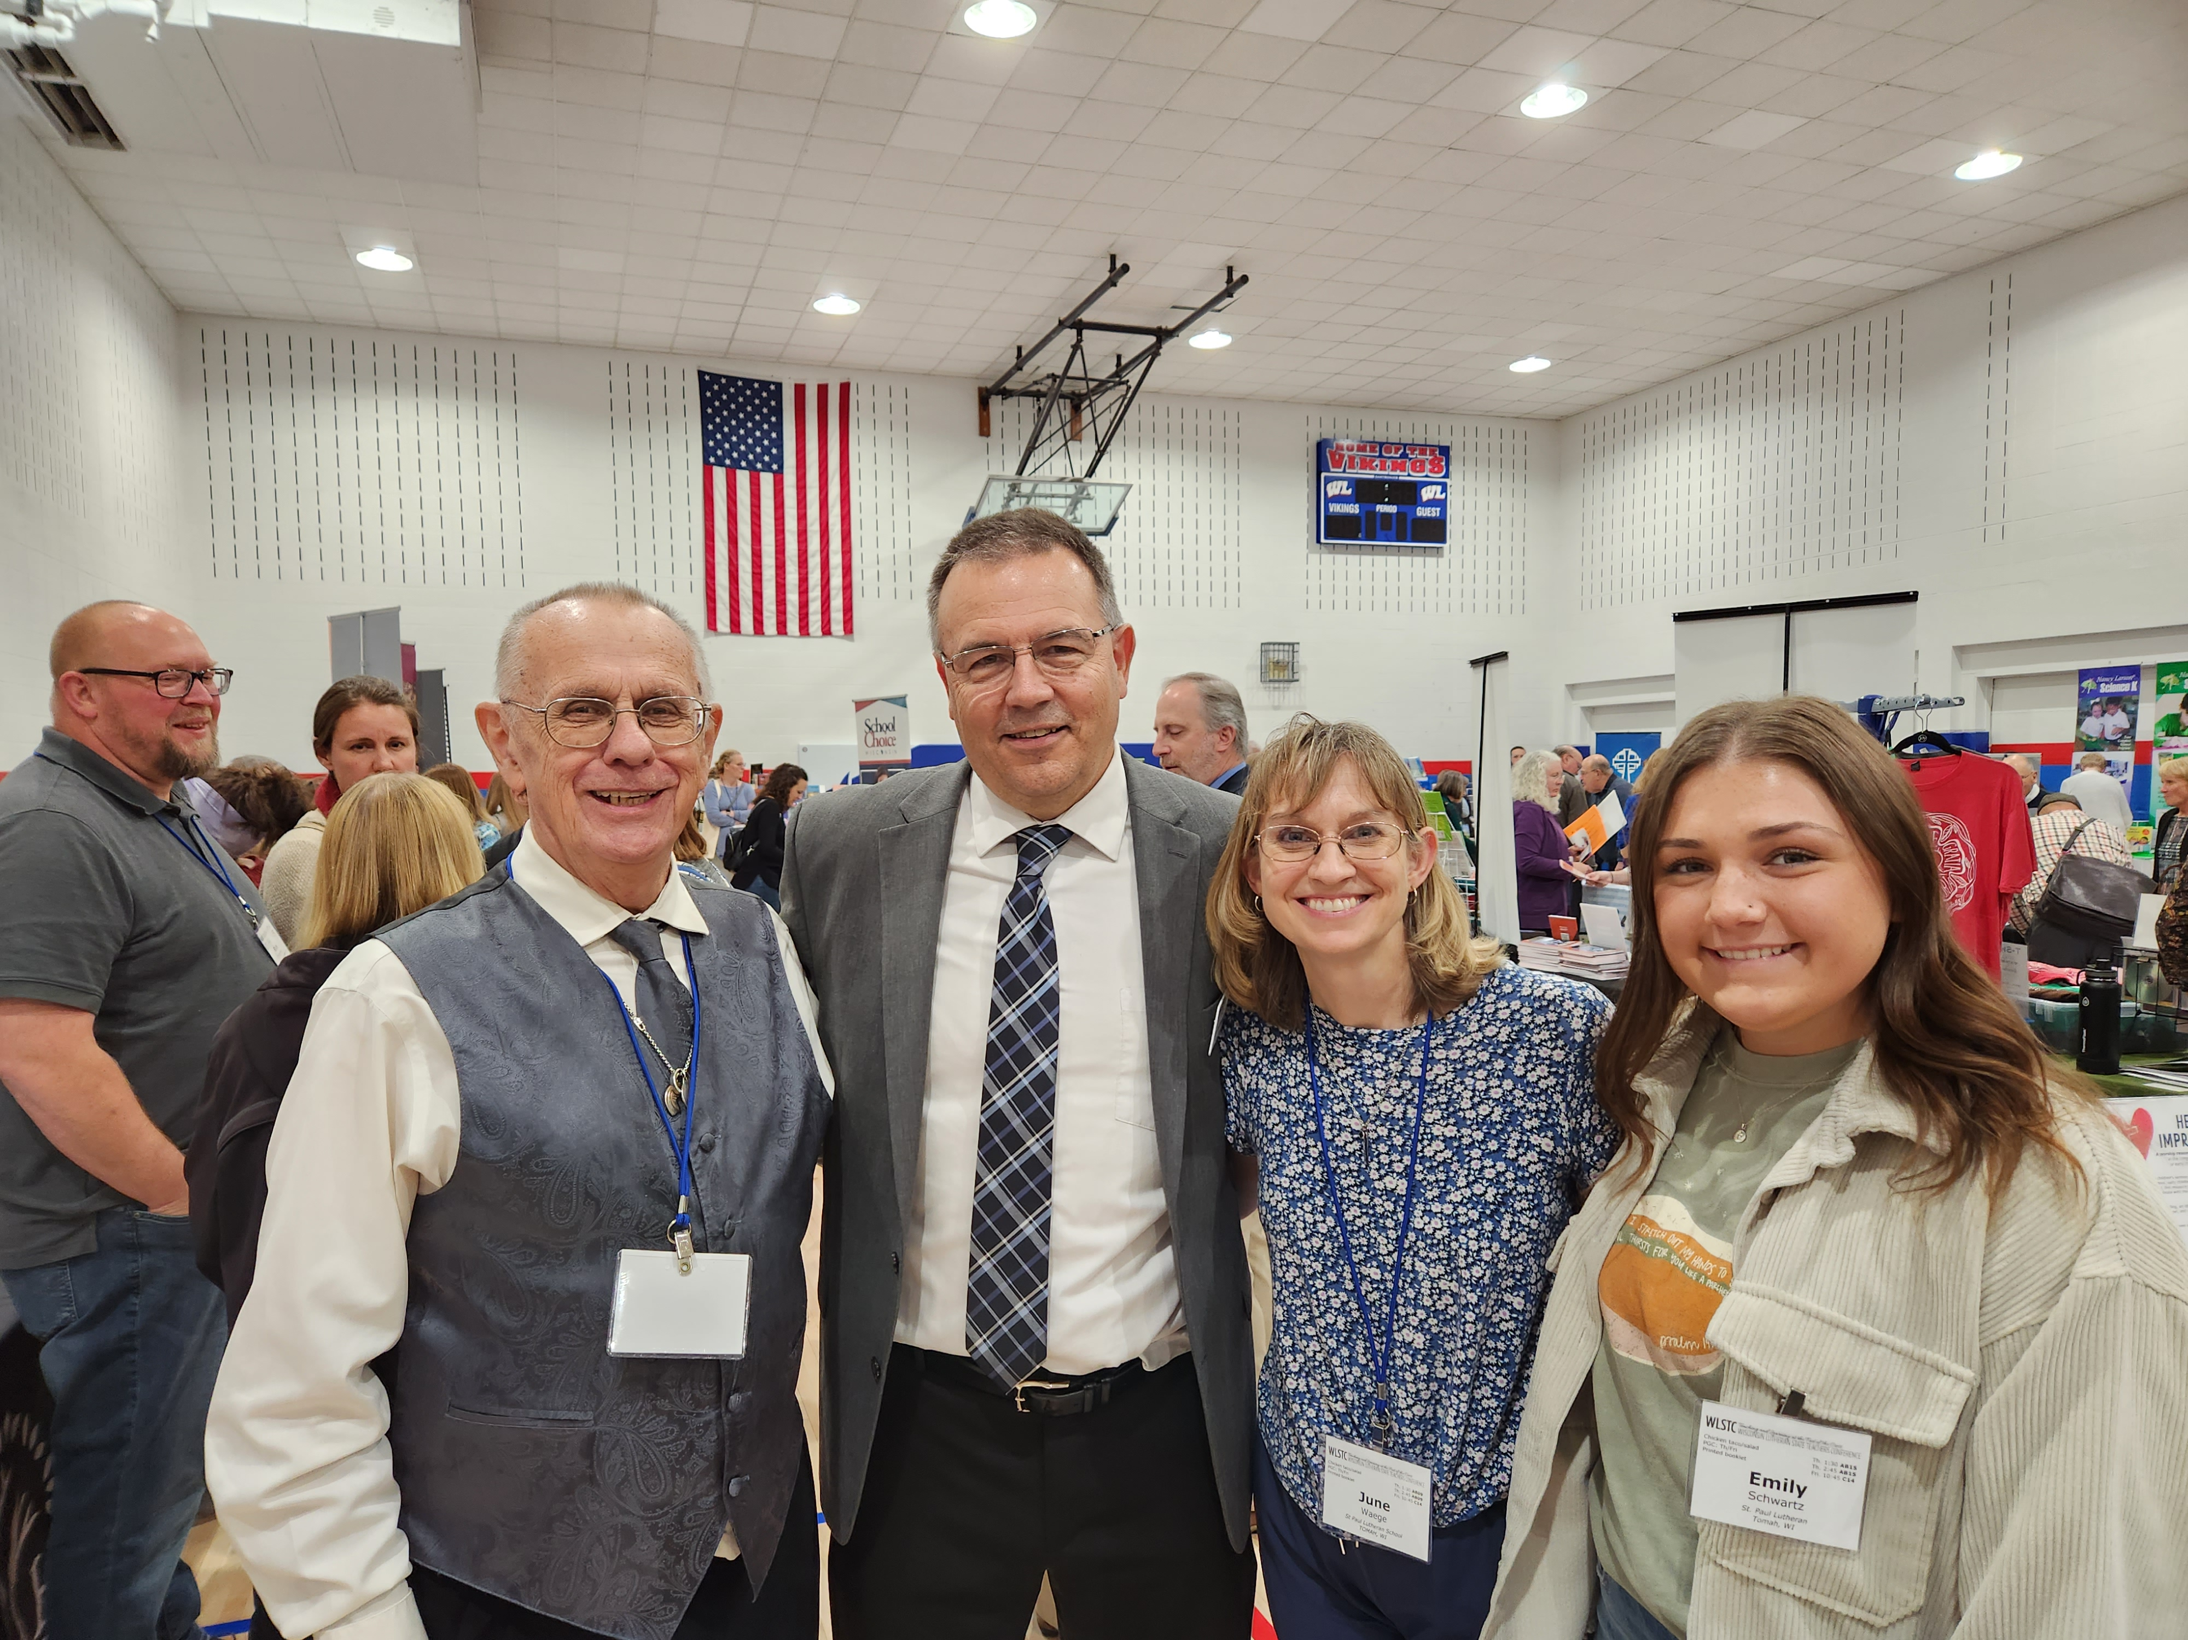
Of the 185 Accepted Calls This Season
Meet George Radloff!
Never served in a WELS School -33
19 First Time Called WELS member no certification
8 First time called WELS member in ministry certification program
6 First time called and degree from MLC
Previously Called but inactive at least a Year - 30
Active and Called from the Field - (18.8% Current Acceptance Rate)
122 Actively serving elsewhere accepted call to new location
Notes:
We continue to see about 1/3 of teachers accepting calls have either never served in a WELS school ( ie. WELS Member serving in Public School), or they have been a called worker in the past but inactive at least a year.
Calling a teacher from another school who is active has a 19.1% acceptance rate this call season.

Slide 41
In the last biennium . . .
220 former called workers have accepted calls back into the teaching ministry
211 WELS members with education degrees who served in public or other non-WELS schools have accepted provisional calls to serve in WELS schools
Notes:
WELS has about 3,000 called teachers nation wide. We praise the Lord for the 154 ministry trained workers who were inactive but accepted calls back into ministry, and
The 105 WELS members with Education degrees who were trained somewhere other than MLC and have now accepted provisional calls to serve in WELS schools.

Slide 42
Current Called Teachers by Age
3,231 TOTAL
Notes:
WELS has about 3,000 called teachers nation wide. We praise the Lord for the 154 ministry trained workers who were inactive but accepted calls back into ministry, and
The 105 WELS members with Education degrees who were trained somewhere other than MLC and have now accepted provisional calls to serve in WELS schools.

Slide 43
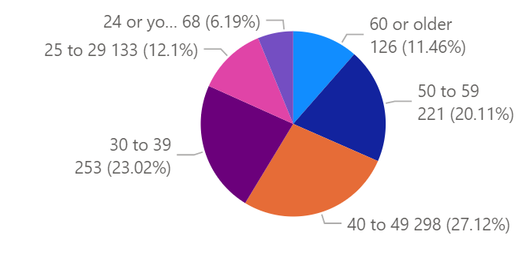
Current Male Called Teachers by Age
1,098 TOTAL
Notes:
WELS has about 3,000 called teachers nation wide. We praise the Lord for the 154 ministry trained workers who were inactive but accepted calls back into ministry, and
The 105 WELS members with Education degrees who were trained somewhere other than MLC and have now accepted provisional calls to serve in WELS schools.

Slide 44
Teacher Retention
School sustainability models
School leader time, training, financial support
Effective board and school leader support and training
Realistic expectations and support of teachers
Opportunities for growth and use of talents
Notes:
WELS has about 3,000 called teachers nation wide. We praise the Lord for the 154 ministry trained workers who were inactive but accepted calls back into ministry, and
The 105 WELS members with Education degrees who were trained somewhere other than MLC and have now accepted provisional calls to serve in WELS schools.

Slide 45
Recruitment: Leveraging the Non-Traditional Path
https://mlc-wels.edu/nep
Notes:
Each year we record the total number of assignments. This slide shares the number of MLC graduates who were called/assigned into the teaching ministry for the first time each year.

Slide 46
CHRISTIAN
CARING

Slide 47
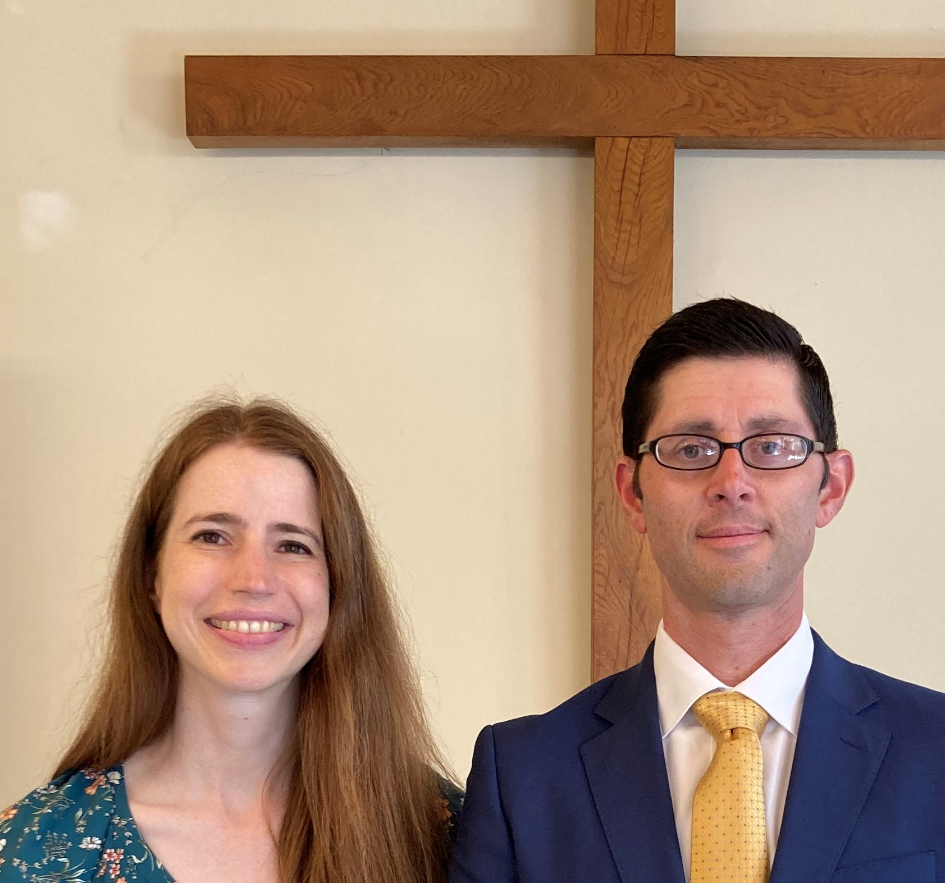
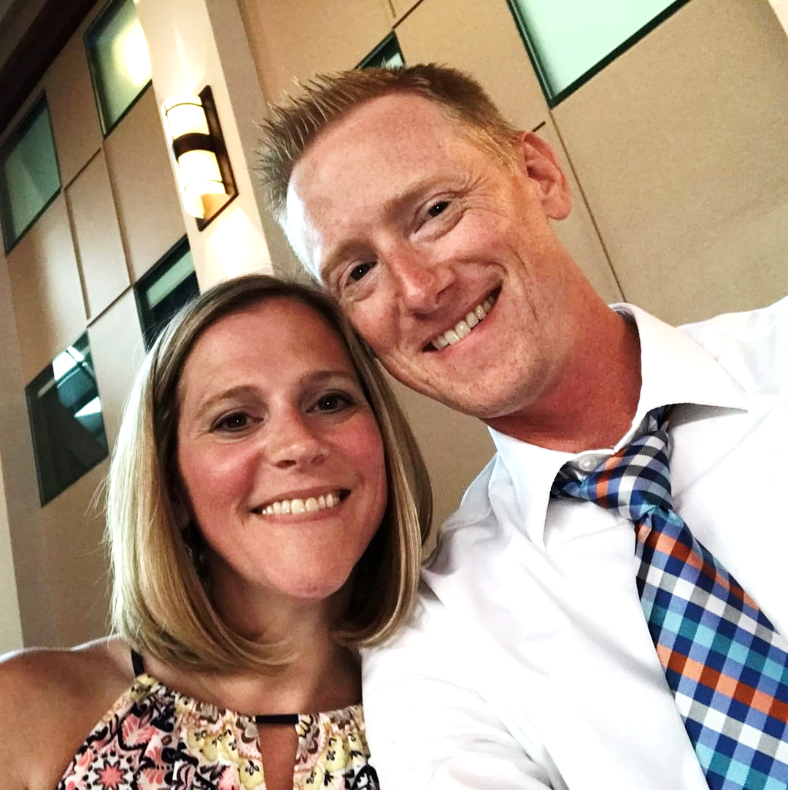
Ministering to Our WELS Military Members
European Chaplain Rob Weiss and his wife, Rachel
National Chaplain Paul Horn and his wife, Becky

Slide 48
WEBSITE
COMING SOON

Slide 49
CONGREGATIONAL SERVICES
CONGREGATIONAL COUNSELING
Jonathan Hein
Coordinator of
Congregational Services
CS OPERATIONS
Dan Nommensen
LUTHERAN SCHOOLS
Jim Rademan
Associate Coordinator of Congregational Services
EVANGELISM
Eric Roecker
WORSHIP
Bryan Gerlach
DISCIPLESHIP
Donn Dobberstein
SPECIAL MINISTRIES
Joel Gaertner
WELS SCHOOL ACCREDITATION
Paul Patterson
EARLY CHILDHOOD MINISTRIES
Cindi Holman
Jim Behringer

Slide 50
WELS Congregational Services
Report to the 2023 synod convention

